Slide 1

STANDARDS:
SS6G4 Locate selected features of Canada.
Locate on a world and regional political-physical map: the St. Lawrence River, Hudson Bay, Atlantic Ocean, Pacific Ocean, the Great Lakes, Canadian Shield, and Rocky Mountains.
Locate on a world and regional political-physical map Canada and the province of Quebec
© Brain Wrinkles

Slide 2
Canada
Canada lies on the ____________________ continent, in the northern and western hemispheres.
It is the ____________________ country in the world—only Russia is bigger.
Its land stretches over ____________________ from one side to the other.
The ____________________ forms Canada’s southern border.
Canada is made up of ____________________ (like states) and three territories.
____________________ is the capital of Canada and it is located in the province of Ontario.
____________________ is located in eastern Canada and is the country’s largest province.
Pacific Ocean
The Pacific Ocean is the ____________________ of the world’s five oceans.
It ____________________ of the earth’s surface.
The Pacific Ocean borders Canada ____________________ .
It is a ____________________ from Canada to Asia.
Atlantic Ocean
The Atlantic Ocean is the ____________________ of the world’s five oceans.
It is the world’s ____________________ ocean.
The Atlantic Ocean borders Canada ____________________ .
It is a major shipping route from Canada to ____________________ .
Canadian Shield
The Canadian Shield is a huge physical region that covers most of ____________________ Canada.
It covers ____________________ of Canada’s land area.
The shield forms a ____________________ around Hudson Bay and stretches from the Great Lakes to the Arctic Ocean.
The Canadian Shield is ____________________ because it is covered in mostly thin soil on top of layers of rock.
However, it is ____________________ , such as trees, minerals, and water.
It also contains ____________________ made by glaciers.
The region is ____________________ .
© Brain Wrinkles
Canada’s Geography CLOZE Notes 1

Slide 3
Hudson Bay
Hudson Bay is a ____________________ located in east-central Canada.
(A gulf is an arm of a sea or ocean ____________________ .)
It is connected to both the ____________________ Oceans.
It is named after the English explorer Henry Hudson.
Grain from Alberta and Saskatchewan is shipped from Hudson Bay out to the Atlantic Ocean and on to other countries ____________________ .
Because of the harsh climate, Hudson Bay is only navigable ____________________ .
Great Lakes
The Great Lakes are ____________________ in central North America.
They are located ____________________ between the United States and Canada.
From east to west, the Great Lakes are Lake Ontario, Lake Erie, Lake Huron, Lake Michigan, and Lake Superior (____________________ ).
The Great Lakes form a valuable ____________________ for many products shipped to and from the US.
The region is one of the world’s ____________________ .
____________________ lives around the Great Lakes region.
Rocky Mountains
The Rocky Mountains are a mountain range located in ____________________ and the United States.
They extend over ____________________ from New Mexico to northern British Columbia.
Because of the terrain, the Rocky Mountains are ____________________ and contain few cities.
There are ____________________ within the Canadian Rockies.
____________________ is the biggest industry in the region, followed closely by logging.
Major minerals found here include iron ore, ____________________ .
The Rockies are also a popular tourist destination, and most of the Canadian Rockies are now protected as ____________________ .
St. Lawrence River
The St. Lawrence River ____________________ with the Atlantic Ocean.
The St. Lawrence River is a huge producer of ____________________ .
It is also a major source of overseas and US-Canada ____________________ .
In 1959, the United States and Canada completed the ____________________ , which is a series of locks, canals, and dams that allow huge cargo ships to travel from the Atlantic Ocean to the Great Lakes.
The seaway has made cities in eastern Canada home to many ____________________.
Because of the climate, the St. Lawrence Seaway is closed from ____________________ .
© Brain Wrinkles
Canada’s Geography CLOZE Notes 2

Slide 4


CANADA’S
GEOGRAPHY
© Brain Wrinkles

Slide 5
Canada
Canada lies on the North American continent, in the northern and western hemispheres.
It is the second largest country in the world—only Russia is bigger.
  Its land stretches over 3,000 miles from one side to the other.
The United States forms Canada’s southern border.
© Brain Wrinkles

Slide 6
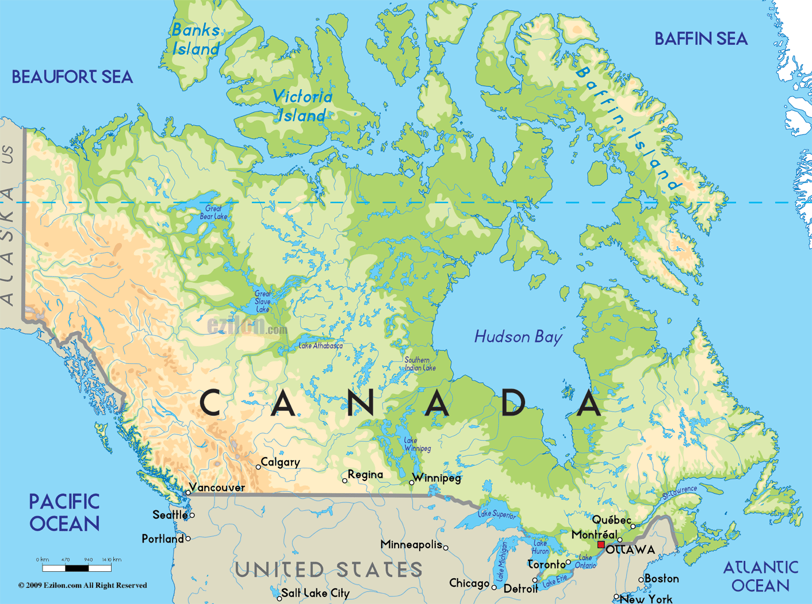
© Brain Wrinkles

Slide 7
Canada
Canada is made up of ten provinces (like states) and three territories.
Ottawa is the capital of Canada and it is located in the province of Ontario.
Quebec is located in eastern Canada and is the country’s largest province.
© Brain Wrinkles

Slide 8
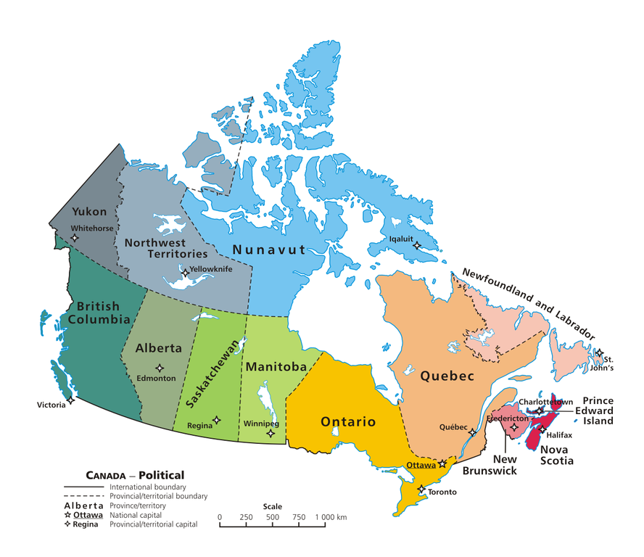
© Brain Wrinkles

Slide 9
Pacific Ocean
The Pacific Ocean is the largest and deepest of the world’s five oceans.
It covers 1/3rd of the earth’s surface.
The Pacific Ocean borders Canada to the west.
It is a major shipping route from Canada to Asia.
© Brain Wrinkles

Slide 10
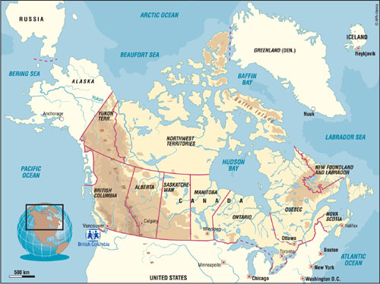
© Brain Wrinkles

Slide 11
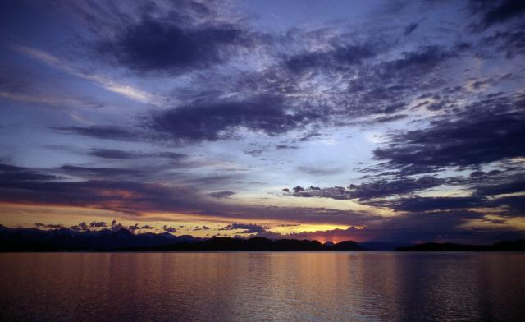
© Brain Wrinkles

Slide 12
Atlantic Ocean
The Atlantic Ocean is the second largest of the world’s five oceans.
It is the world’s most heavily traveled ocean.
The Atlantic Ocean borders Canada to the east.
It is a major shipping route from Canada to Europe and Africa.
© Brain Wrinkles

Slide 13
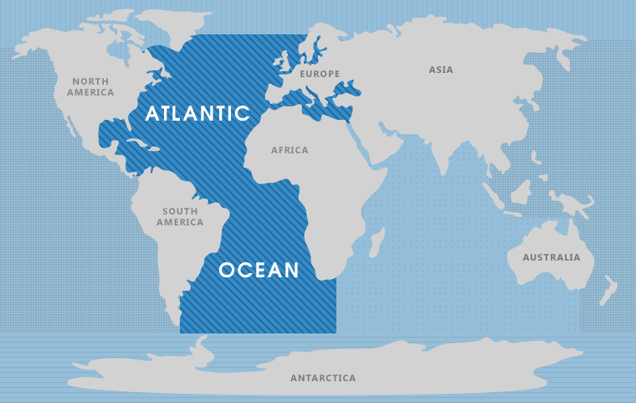
Canada
© Brain Wrinkles

Slide 14
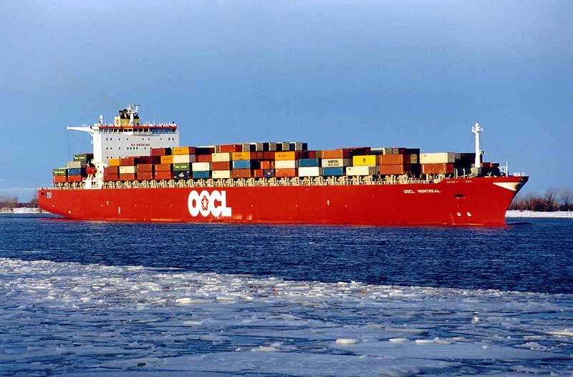
© Brain Wrinkles

Slide 15
Canadian Shield
The Canadian Shield is a huge physical region that covers most of eastern and southern Canada.
It covers nearly half of Canada’s land area.
The shield forms a horseshoe-shaped curve around Hudson Bay and stretches from the Great Lakes to the Arctic Ocean.
© Brain Wrinkles

Slide 16
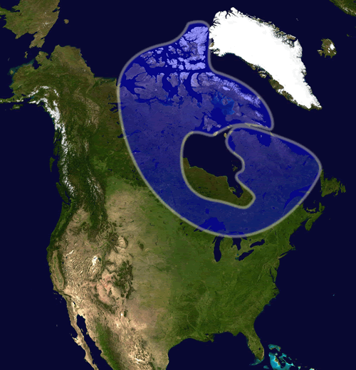
© Brain Wrinkles

Slide 17
Canadian Shield
The Canadian Shield is not good for farming because it is covered in mostly thin soil on top of layers of rock.
However, it is rich in natural resources, such as trees, minerals, and water.
It also contains thousands of lakes made by glaciers.
The region is sparsely populated.
© Brain Wrinkles

Slide 18
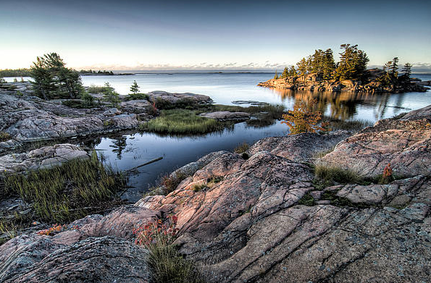
© Brain Wrinkles

Slide 19
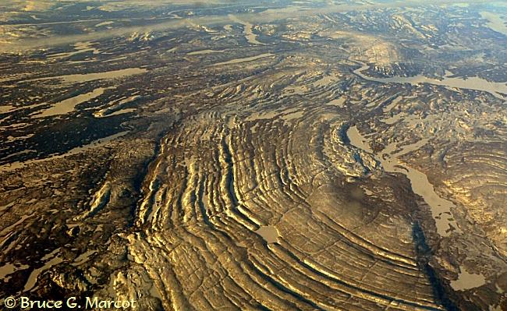
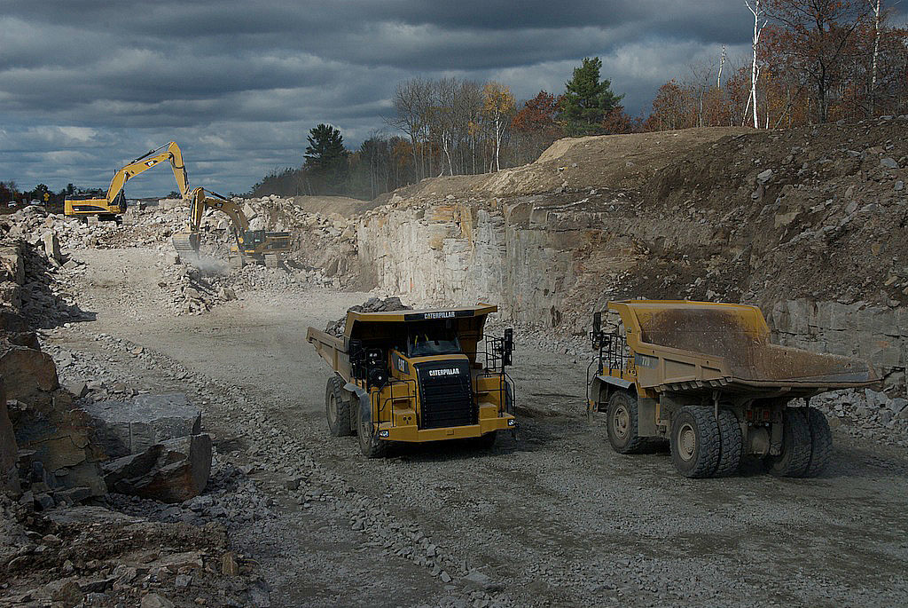
© Brain Wrinkles

Slide 20
Hudson Bay
Hudson Bay is a massive gulf located in east-central Canada.
  (A gulf is an arm of a sea or ocean partly enclosed by land.)
It is connected to both the Atlantic and Arctic Oceans.
It is named after the English explorer Henry Hudson.
© Brain Wrinkles

Slide 21
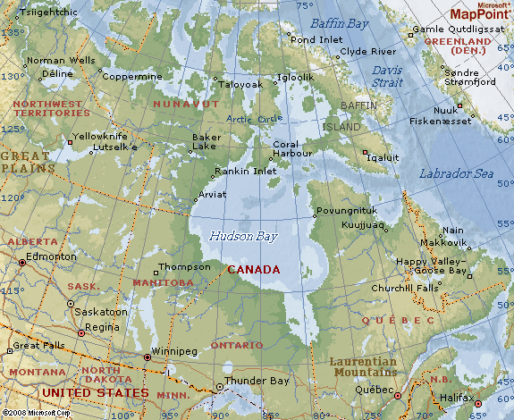
© Brain Wrinkles

Slide 22
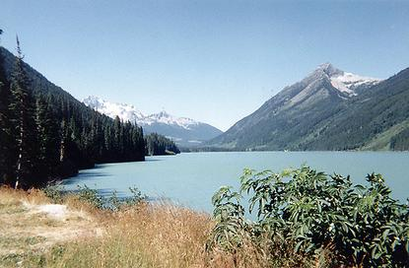
© Brain Wrinkles

Slide 23
Hudson Bay
Grain from Alberta and Saskatchewan is shipped from Hudson Bay out to the Atlantic Ocean and on to other countries around the world.
Because of the harsh climate, Hudson Bay is only navigable from July to October.
© Brain Wrinkles

Slide 24
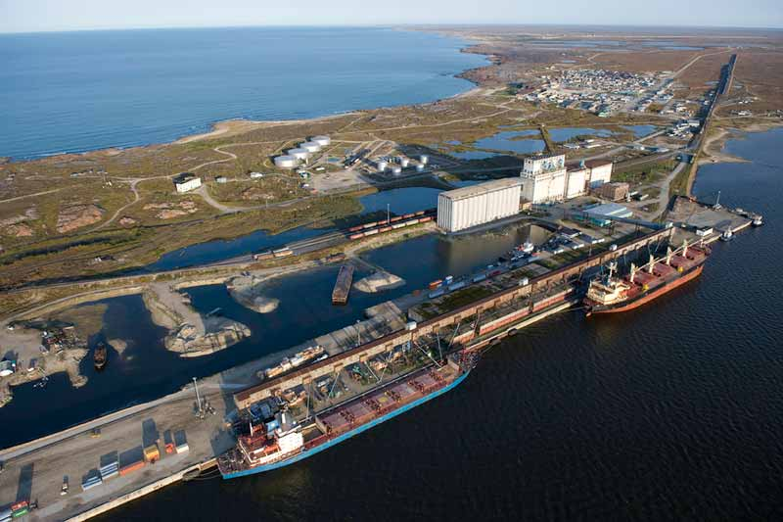
© Brain Wrinkles

Slide 25
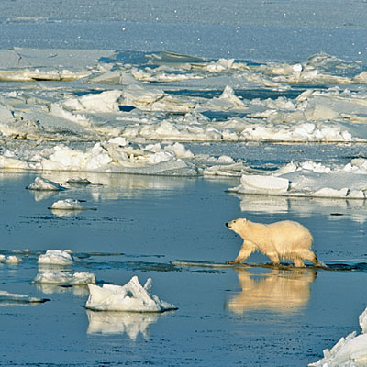
© Brain Wrinkles

Slide 26
Great Lakes
The Great Lakes are five freshwater lakes in central North America.
They are located along the border between the United States and Canada.
From east to west, the Great Lakes are Lake Ontario, Lake Erie, Lake Huron, Lake Michigan, and Lake Superior (HOMES).
© Brain Wrinkles

Slide 27
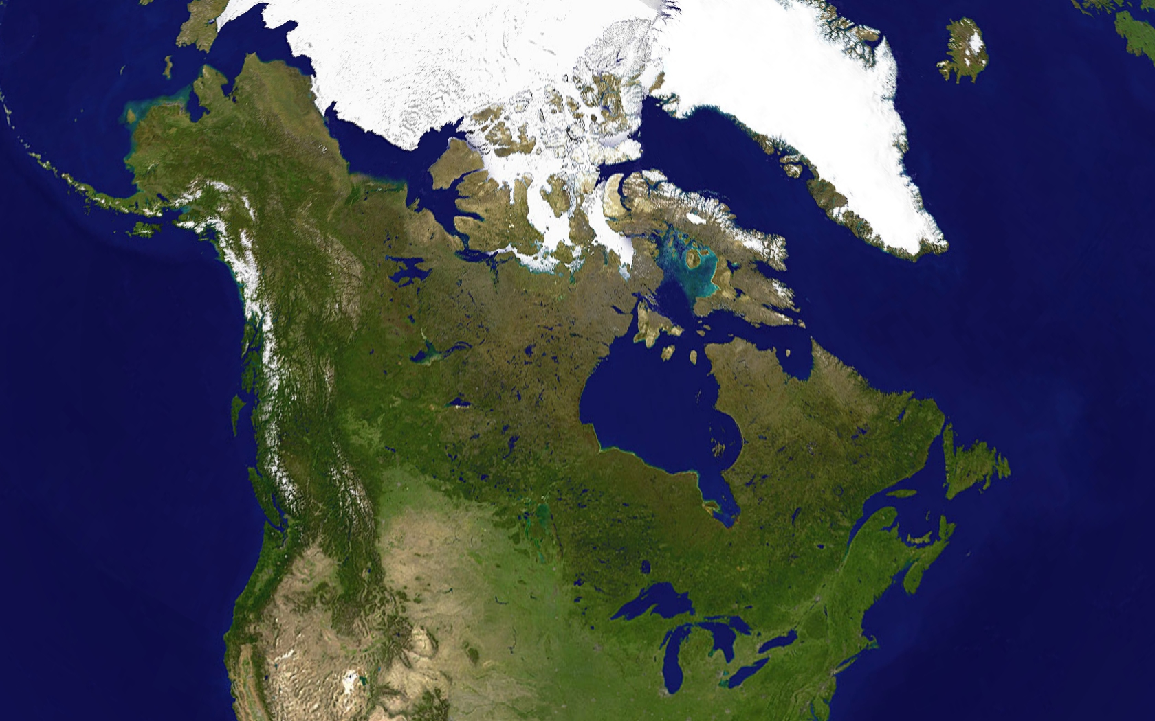
© Brain Wrinkles

Slide 28
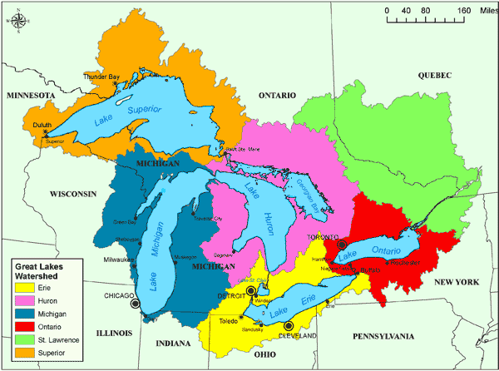
© Brain Wrinkles

Slide 29
Great Lakes
The Great Lakes form a valuable transportation network for many products shipped to and from the US.
The region is one of the world’s busiest shipping areas.
Much of Canada’s population lives around the Great Lakes region.
© Brain Wrinkles

Slide 30
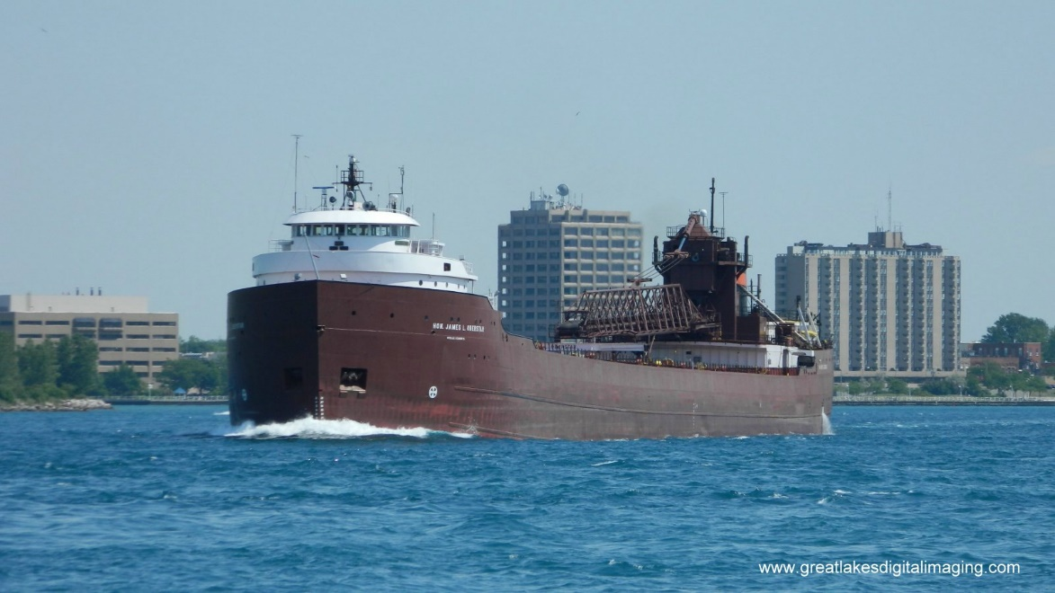
© Brain Wrinkles

Slide 31
Rocky Mountains
The Rocky Mountains are a mountain range located in western Canada and the United States.
They extend over 2000 miles from New Mexico to northern British Columbia.
Because of the terrain, the Rocky Mountains are sparsely populated and contain few cities.
© Brain Wrinkles

Slide 32
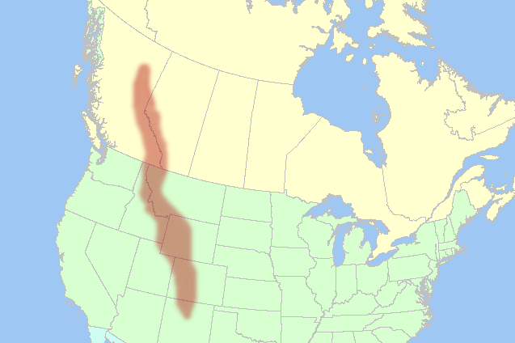
© Brain Wrinkles

Slide 33
Rocky Mountains
There are numerous glaciers within the Canadian Rockies.
Mining is the biggest industry in the region, followed closely by logging.
Major minerals found here include iron ore, copper, coal, and gold.
The Rockies are also a popular tourist destination, and most of the Canadian Rockies are now protected as national parks.
© Brain Wrinkles

Slide 34
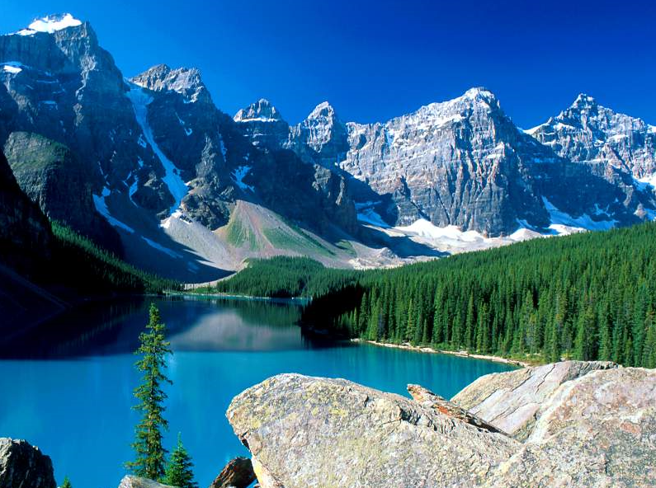
© Brain Wrinkles

Slide 35
St. Lawrence River
The St. Lawrence River connects the Great Lakes with the Atlantic Ocean.
The St. Lawrence River is a huge producer of hydroelectricity.
It is also a major source of overseas and US-Canada shipping and trading.
© Brain Wrinkles

Slide 36
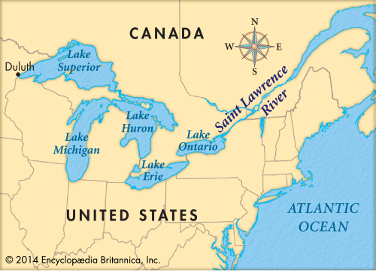
© Brain Wrinkles

Slide 37
St. Lawrence River
In 1959, the United States and Canada completed the St. Lawrence Seaway, which is a series of locks, canals, and dams that allow huge cargo ships to travel from the Atlantic Ocean to the Great Lakes.
The seaway has made cities in eastern Canada home to many successful manufacturing companies.
Because of the climate, the St. Lawrence Seaway is closed from November to April.
© Brain Wrinkles

Slide 38
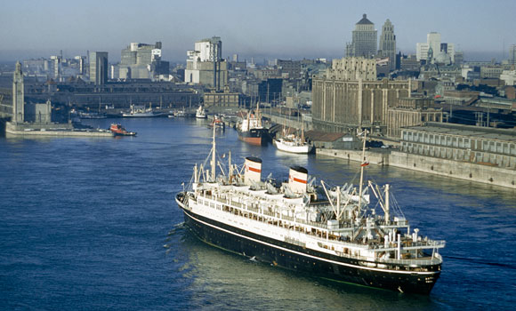
© Brain Wrinkles

Slide 39
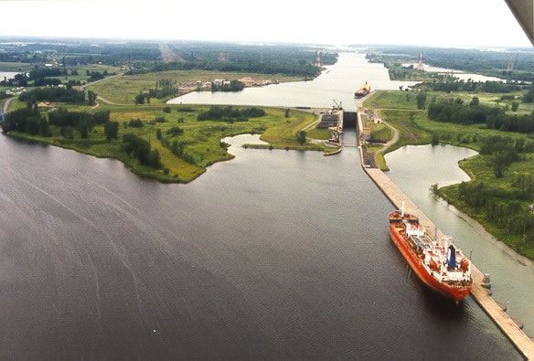
© Brain Wrinkles

Slide 40
What:
Where:
Illustration:
What:
Where:
Illustration:
What:
Where:
Illustration:
What:
Where:
Illustration:
© Brain Wrinkles
Hudson Bay
Canadian Shield
Atlantic Ocean
Pacific Ocean
Directions: Complete the chart below with information that you learned during the presentation. If time allows, color your illustrations.
Canada’s Physical Features
What:
Where:
Illustration:
What:
Where:
Illustration:
What:
Where:
Illustration:
St. Lawrence River
Rocky Mountains
Great Lakes

Slide 41
You Are Now Entering…
Directions: Choose one of Canada’s physical features and create a “welcome sign” that visitors will see as they enter the feature’s region. The sign should include key facts about the feature, as well as significant illustrations.
© Brain Wrinkles

